Slide 1
Bug Triage with Natural Language Processing
Team: Frank Russo, Carlo Clarke, Ramya Raju
Client: Ning Yang, Anthony Escalona
Student-Faculty Research Day Conference
CSIS, Pace University
Notes:
Welcome to our presentation.
We will be discussing Bug Triage with Natural Language Processing.
My name is Frank Russo.
My team members are Carlo Clarke and Ramya Raju.
Our clients were Ning Yang and Anthony Escalona.

Slide 2
Agenda
Introduction:
What is bug triage?
Literature Review
word2vec
Long Short-Term Memory
Naive Bayes
Methodology
Results
word2vec/LSTM
Naive Bayes
Conclusion
Notes:
The agenda for this presentation start with and introduction <click>
What is bug triage? <click>
We’ll then talk about our Literature Review and the Machine Learning topics we researched such as <click>
word2vec <click>
Long short-term memory <click>
And Naive Bayes classifiers.<click>
We’ll then walk you through the Methodology explaining the code. <click>
We’ll then show the results of the code execution.<click>
first from the word2vec with LSTM models <click>
and next from the Naive Bayes model <click>
And final we’ll show you our conclusion.

Slide 3
Introduction: What is bug triage?
All software written has bugs
Assigning bugs to the right developer is time consuming
Machine Learning techniques can be used to assign bugs to developers
Notes:
All software written has bugs or defects which need to be fixed
The process of assigning bugs to the right developer could be a time consuming process
Machine Learning techniques can be used to effectively assign bugs to developers alleviating the need for manual processing of bugs

Slide 4
Literature Review
Machine Learning/Natural Language Processing
Word2vec
Long Short-term Memory
Naive Bayes
Notes:
In our research, we look at the following areas of ML.
Machine Learning and more specifically Natural Language Processing
Which includes: word2vec
Long Short-term Memory or LSTM
And Naive Bayes

Slide 5
Literature Review: word2vec
Algorithms for unsupervised training of vectors of words.
Model types:
Neural Bag-of-Words (NBOW)
Recurrent Neural Network (RNN)
Recursive Neural Network (RecNN)
Convolutional Neural Network (CNN)
Highly accurate guesses
Notes:
Word2vec is a set of algorithms for unsupervised training of vectors of words on large blocks of text. The resulting vectors show semantic relationships between their corresponding words.
There are several types of models, for example,
Neural Bag-of-Words (NBOW),
Recurrent Neural Network (RNN),
Recursive Neural Network (RecNN), and
Convolutional Neural Network (CNN).
Given enough data, usage and contexts, word2vec can make highly accurate guesses about a word’s meaning based on past appearances.

Slide 6
Literature Review: Long short-term memory
RNN capable of learning order dependencies in sequences to predict problems.
Hidden memory cell to update and expose the content
Two types of LSTM:
Unidirectional
Bidirectional
Notes:
LSTM is a type of RNN capable of learning order dependencies in sequences to predict problems.
It does that by using a hidden memory cell to update and expose the content when needed.
There are two types of LSTM, Unidirectional LSTM only preserves information of the “past” because the only inputs it has seen are from the past.
Bidirectional, which is the type of model we used on this project, is an extension of traditional LSTM that can improve model performance on sequence classification problems. It does this by looking ahead of the current word in a sequence.

Slide 7
Literature Review: Naive Bayes
Set of classifiers
Based on Bayes’ theorem
Text categorization
Types of Naive Bayes Classifier
Multinomial Naive Bayes
Bernoulli Naive Bayes
Gaussian Naive Bayes
Notes:
Naive Bayes is a set of machine learning classifiers
Based on Bayes' theorem in probability and statistics.
Naive Bayes classifiers are typically used as a method for text categorization. Usually multiple classifiers are applied to a dataset with each classifier having equal weight.
There are different type of Naive Bayes Classifiers:
Multinomial Naive Bayes is mostly used for document classification problem, i.e whether a document belongs to the category of sports, politics, technology, etc. The features/predictors used by the classifier are the frequency of the words present in the document.
Bernoulli Naive Bayes is similar to the multinomial naive bayes but the predictors are boolean variables, for example if a word occurs in the text or not.
And lastly, there is Gaussian Naive Bayes, which is not something
we looked at in our research.

Slide 8
Methodology: Data
2 sets of Data:
Training Data
Test Data
Notes:
Here we move into the Methodology section of the paper, where we cover the code starting with the data.
We first load two sets of data.
1) The training data is triaged bug dataset that is used for classifier training and testing by cross validation.
2) The test data is an untriaged bug dataset that learns from the target deep learning model in an unsupervised manner.

Slide 9
Methodology: Cleanse Test Data
{
"id" : 1,
"issue_id" : 2,
"issue_title" : "Testing if chromium id works",
"reported_time" : "2008-08-30 16:00:21",
"owner" : "",
"description" : "\nwhat steps will reproduce the problem\n1\n2\n3\n\r\nwhat is the expected output what do you see instead\n\r\n\r\nplease use labels and text to provide additional information\n \n"
}
Notes:
It is necessary to preprocess the data so that we can process the valid data easier.
For the untriaged dataset, we only focus on the issue_title and description. We remove things like the the return character "\r", the newline character, any URLs, stack traces, hex codes and so on, and we store the remaining words into an array.

Slide 10
Methodology: Execute word2vec Method
Continuous Bag of Words model
Extract the vocabulary
Notes:
We use the word2vec method to learn a bug's representation using what is called a
Continuous Bag of Words model.
We then extract vocabulary from the output of that method.

Slide 11
Methodology: Cleanse Training Data
{
"owner" : "amit@chromium.org",
"issue_title" : "Scrolling with some scroll mice (touchpad, etc.) scrolls down but not up",
"description" : "\nProduct Version : <see about: version>\r\nURLs (if applicable) :0.2. 149.27\r\nOther browsers tested: Firefox / IE\r\nAdd OK or FAIL after other browsers where you have tested this issue:\nSafari 3:\n Firefox 3: OK\r\n IE7:OK\r\n\r\nWhat steps will reproduce the problem?\n1. Open any webpage on compaq 6715s running vista.\r\n2. Try scrolling with the touchpad\r\n3. Scrolling down will work , but up will not.\r\n\r\nWhat is the expected result?\nThe page to scroll up.\r\n\r\nWhat happens instead?\nThe page doesn’t move.\r\n\r\nPlease provide any additional information below. Attach a screenshot if \r\npossible.\r\nOnly a minor bug .\n "
}
Notes:
Next we cleanse the training data similar to the testing data.
So again, we remove things like the the return character "\r", the newline character, any URLs, stack traces, hex codes and so on, and store the remaining words into an array.

Slide 12
Methodology: Cross Validation
Triaged bug dataset is divided into parts. eg: 3
Iteration 1:
Train data: sub1
Test data: sub1
Iteration 2:
Train data: sub1 + sub2
Test data: sub2
Iteration 3:
Train data: sub1 + sub2 + sub3
Test data: sub3
Notes:
Next we go through the process of Cross Validation, which is needed to remove any bias in the training data.
The way this works is to start with the number of cross validations. For example, if that number is 3, the whole triaged bug dataset is divided into three parts. We can call them, sub1, sub2 and sub3.
In the first iteration, we use sub1 as training data and we also use sub1 as testing data.
In the second iteration, we use sub1 + sub2 as training data and use sub2 as testing data.
In the third iteration, we use sub1 + sub2 + sub3 as training data and use sub3 as testing data.

Slide 13
Methodology: Deep Learning Model
Looks at word sequence, forward and backward
LSTM
Solves Vanishing Gradient Problem
Notes:
This model considers the word sequence both in forward direction and in backward direction so that a context of a particular word includes both the previous few words and following few words making the representation more robust.
This is where Long short-term memory cells are used in the hidden layer which have a memory unit that can remember longer word sequences.
This allows us to solve the vanishing gradient problem, which is a typical problem in training neural networks. This is the main reason we use LSTM.

Slide 14
Methodology: Naive Bayes Model
Multinomial Naive Bayes classifier type, eg word counts for text classification
Create a classifier model
OneVsRestClassifier strategy
Probability estimates using frequency-based bag-of-words model
Real data to test accuracy
Notes:
Earlier, we mentioned the different types of Naive Bayes classifiers. In our case, we use the Multinomial Naive Bayes classifier type to perform word counts for text classification.
Firstly, we create a classifier model for multinomial Naive Bayes.
Secondly, we use OneVsRestClassifier strategy to fit underlying estimators. This strategy splits a multi-class classification into one binary classification problem per class. Since each class is represented by one and one classifier only, it is possible to gain knowledge about the class by inspecting its corresponding classifier.
Third, we use a frequency-based bag-of-words model to make the probability estimates.
Finally, we use the real data to get test accuracy.

Slide 15
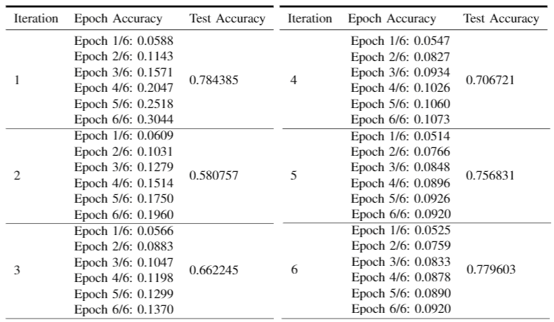
Results: word2vec with LSTM
Notes:
Moving onto the results.
This table shows the accuracy of the model’s output for each epoch per iteration along with the accuracy of the model for the entire iteration.
(Epochs are a single pass through the entire dataset within an iteration.)

Slide 16
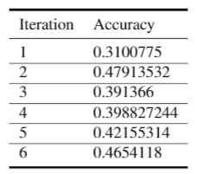
Results: Naive Bayes
Notes:
This table shows the accuracy of running the same data through the Naive Bayes classifier.

Slide 17
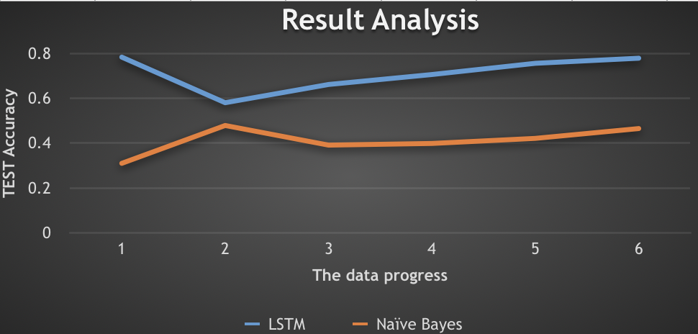
Conclusion:
Notes:
The graph here shows a comparison of the accuracy of both the word2vec with LSTM approach and the Naive Bayes approach. The blue line shows the LSTM accuracy, and the the orange line shows the Naive Bayes accuracy.
The conclusion of the paper is that even though both approaches are capable of solving the problem of bug triage and will lead to improved times in triaging and ultimately in earlier bug fixes for important defects, the graph clearly shows the accuracy of the word2vec with LSTM method was better than the Naive Bayes method.

Slide 18
Questions
Please unmute if you’d like to ask any questions.
Notes:
I’d like to thank everyone for their time. Please unmute if you’d like to ask any questions.

Slide 19
The End……….

